Slide 1

Blue 10

Slide 2
THESE TOP FOUR CLUSTERS MAKE UP ABOUT 67% OF THE TEAM’S SAMPLE CLUES

Slide 3
WHAT ARE CLUSTERS 11, 14, 0, AND 9?
Notes:
Science, History, Historical figures, and Movies and Entertainment

Slide 4
THESE BOTTOM FOUR CLUSTERS MAKE UP LESS THAN 8% OF THE TEAM’S SAMPLE CLUES

Slide 5
WHAT ARE CLUSTERS 3, 12, 6, AND 2?

Slide 6
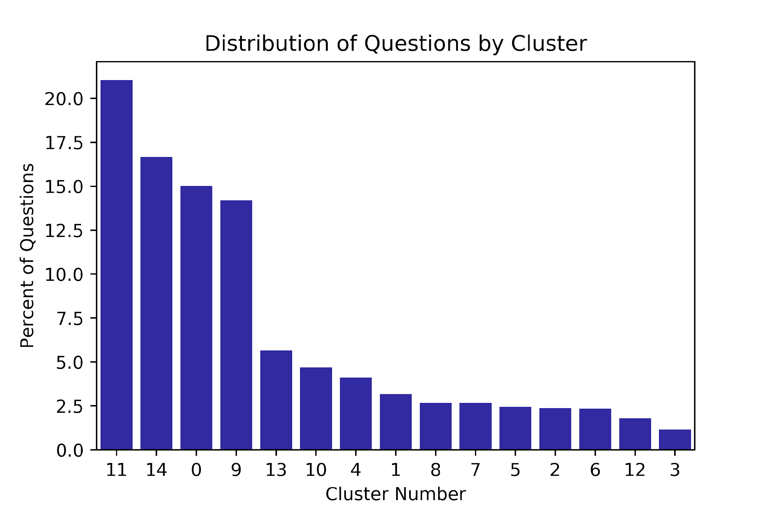
Focused Study Strategy
Notes:
Science, History, Historical figures, and Movies and Entertainment
67%
2 in 3

Slide 7
Jeopardy Text Analysis
Clue length
Clue Clustering
Clue 🡪 Cluster demo
Conclusion and Questions

Slide 8
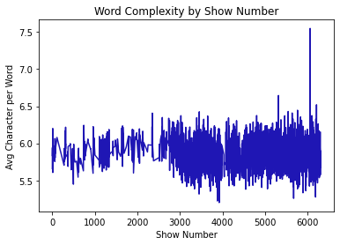
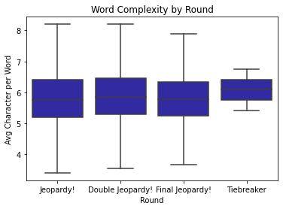
Clue Length
Clue Length
Clue Clustering
Demo
Conclusion
Notes:
Dark jeopardy blue hex #1F16B4
Purple #9B0EAA
Orange #FCA11D
Pink #ec0370

Slide 9
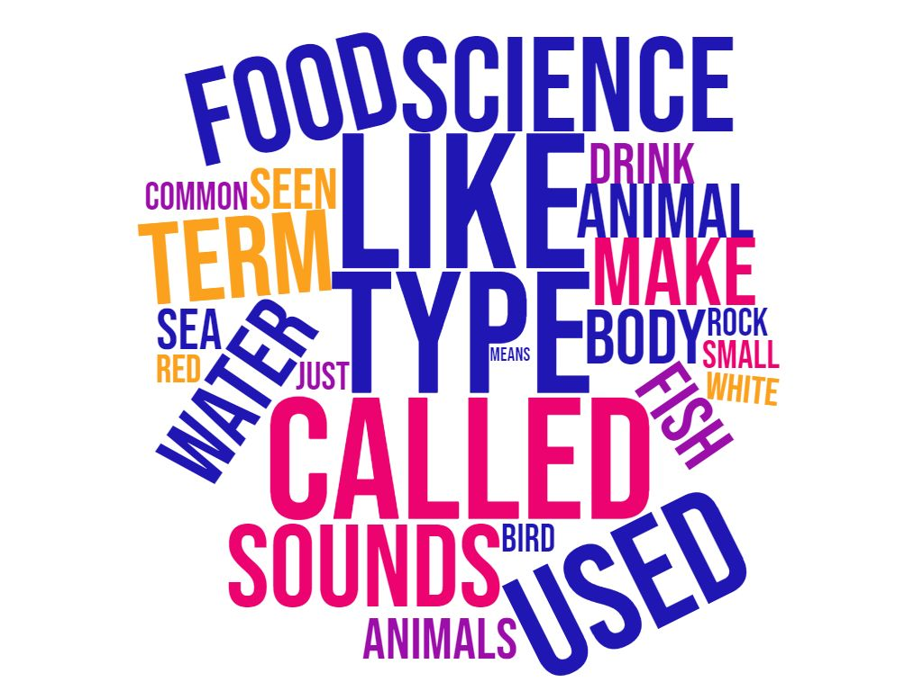
Top 4 Clusters
Cluster 11
Science
21.04%
Clue Length
Clue Clustering
Demo
Conclusion

Slide 10
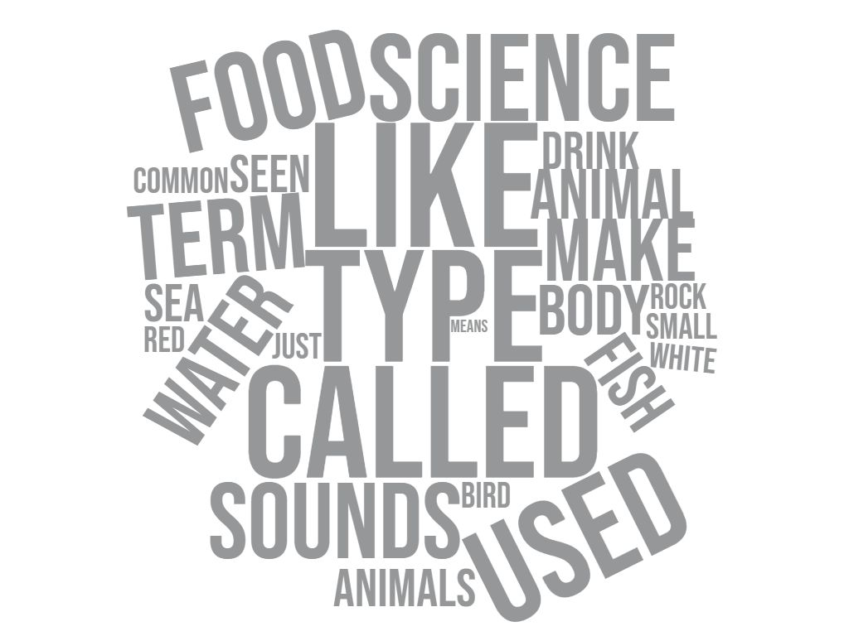

Top 4 Clusters
Cluster 14
History
16.67%
Clue Length
Clue Clustering
Demo
Conclusion

Slide 11

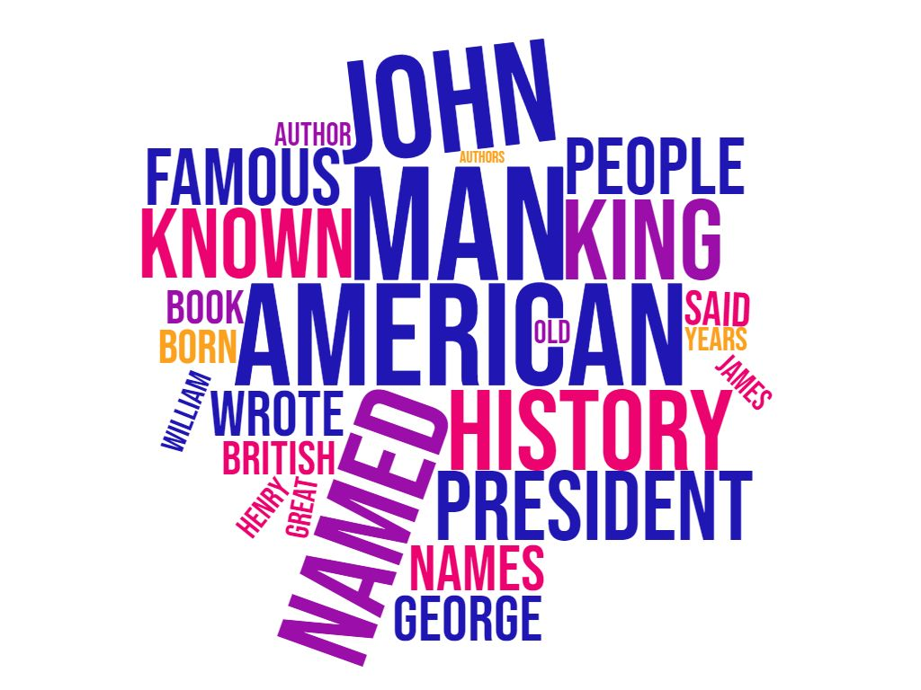
Top 4 Clusters
Cluster 0
Historical Figures
15.02%
Clue Length
Clue Clustering
Demo
Conclusion

Slide 12
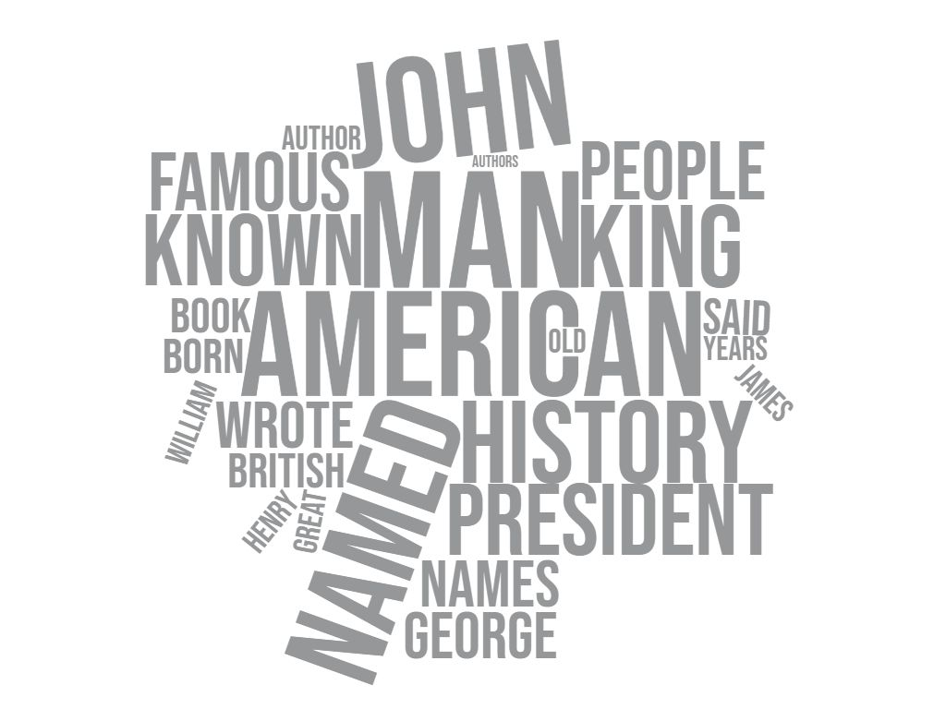
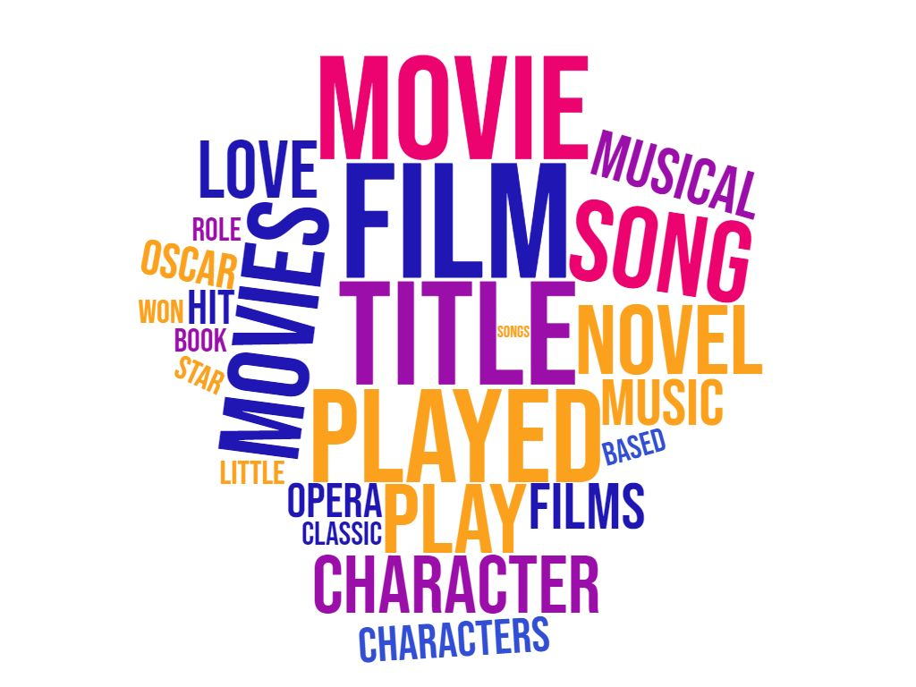
Top 4 Clusters
Cluster 9
Movies and Entertainment
14.20%
Clue Length
Clue Clustering
Demo
Conclusion

Slide 13
Top 4 Clusters
Cluster 11
Science
21.04%
Cluster 14
History
16.67%
Cluster 0
Historical Figures
15.02%
Cluster 9
Movies and Entertainment
14.20%
Clue Length
Clue Clustering
Demo
Conclusion

Slide 14
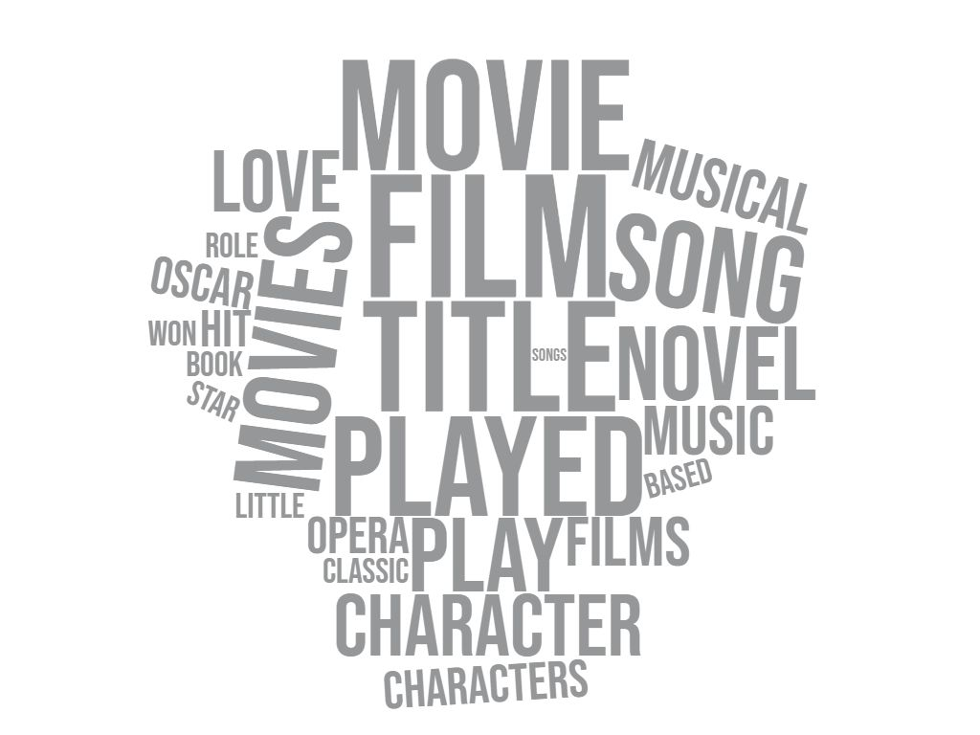
Top 4 Clusters
Cluster 11
Science
xx%
Clue Length
Clue Clustering
Demo
Conclusion

Slide 15
Bottom 4 Clusters
Clusters
2 Cities
6 World Geography
12 War History
3 Word Puzzles
Clue Length
Clue Clustering
Demo
Conclusion

Slide 16
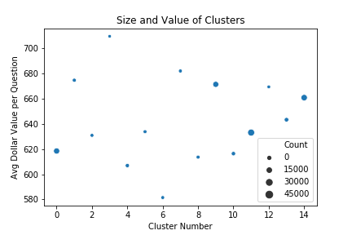
Cluster Size vs Value
Clue Length
Clue Clustering
Demo
Conclusion

Slide 17
Dr. Race’s Clues
C: This English writer was best known for her stories about a rabbit with 3 sisters named Flopsy, Mopsy, and Cottontail.
R: Who is Beatrix Potter?
Cluster 0: Historical Figures
C: This mathematical equation, relating the sides of a triangle to the length of its hypotenuse, was one of the earliest theorems known to ancient civilizations.
R: What is the Pythagorean Theorem?
Cluster 11: Science
Clue Length
Clue Clustering
Demo
Conclusion

Slide 18
Conclusion
Focus on Science, History, Historical Figures, and Movies and Entertainment
1 in 13 clues come from bottom 4
Importance of cluster size versus average value
Dr. Race is an ideal study buddy
Clue Length
Clue Clustering
Demo
Conclusion
Notes:
Focus studying on science, history, historical figures, and movies and entertainment – they make up over two thirds of questions
Don't waste your time on somename, war history, world geography, and cities – only 1 in 13 questions are about these
The narrow spread of average cluster value makes size the more critical factor
Dr. Race makes a great Jeopardy! Study buddy – both her questions fell into top clusters

Slide 19
WHAT ARE THE AUDIENCE QUESTIONS?

Slide 20
Extra slides for potential Q&A

